Slide 1
LA FOIP 101: What Municipalities Need to Know
Diane Aldridge, Director of Compliance
Office of the Saskatchewan Information and Privacy Commissioner

Slide 2
Outline
Disclaimer
LA FOIP
Municipal Legislation
Access to Information
Request for Review
Highlights of Review Reports
Privacy and personal information
Collection, use and disclosure
Safeguards
Privacy breaches and investigations by IPC
Issues and Trends
Wrap-up and Q&As

Slide 3
Disclaimer
Materials prepared are by the IPC to assist persons in understanding the laws discussed and access and privacy best practices
Only offered as non-binding, general advice as we cannot give advanced rulings
Unable to discuss specific past or present cases unless Report issued or details otherwise publicly known

Slide 4
LA FOIP
In force effective July 1, 1993
Significant amendments January 1, 2018
What it does:
Sets out the rules for access to records in the possession or under the control of a local authority; exceptions are limited and specific; and provides right to request correction/amendment
It sets out the rules for the collection, use and disclosure of personal information by those same bodies
It provides a right to complain to the Commissioner

Slide 5
Application
LA FOIP applies to “local authorities” that include:
2(f) “local authority” means:
(i) a municipality;
…
(v) any board, commission or other body that:
(A) is appointed pursuant to The Cities Act, The Municipalities Act or The Northern Municipalities Act, 2010; and
(B) is prescribed;
Appendix
PART I
Boards, Commissions and Other Bodies Prescribed as Local Authorities
[Subclause 2(f)(v) of the Act]
A board, commission or other body established pursuant to The Cities Act
A board, commission or other body established pursuant to The Municipalities Act
A board, association, commission or other organization appointed pursuant to The Northern Municipalities Act.

Slide 6
Municipal Legislation
The Cities Act, The Municipalities Act, and The Northern Municipalities Act, 2010
On privacy, LA FOIP leads and municipal acts support
Administrator and clerk in charge of keeping municipal documents and records safe (CA s. 85; MA s. 111; NMA s. 127)
Requires certain documents to be public – approved minutes, financial statements, contracts approved by council (CA s. 91; MA s. 117; NMA s. 133)
Sets rules for when meetings can be closed to public – LA FOIP exception, long-range or strategic planning (CA s. 94; MA s. 120; NMA s. 138)

Slide 7
Access to Information
About being open and accountable
Right is to access to copies of source documents
Summary, condensation, or secondary document is no satisfactory substitute
Information in any recorded form or format
Possession or control
Not answers to questions
Not time limited in terms of when created

Slide 8
delegation
Section 50 of LA FOIP
50(1) A head may delegate to one or more officers or employees of the local authority a power granted to the head or a duty vested in the head.
(2) A delegation pursuant to subsection (1):
(a) is to be in writing; and
(b) may contain any limitations, restrictions, conditions or requirements that the head considers necessary.
The IPC recommends that the administrator receive training and be responsible for:
Corporate information, including personal information at the Municipality of residents and employees.
Providing guidance with respect to this policy and ensuring this policy is followed.
Receiving and managing all access to information requests including the application of all exemptions and working with the IPC when a review is undertaken.

Slide 9
Processing requests
Once you have the $20 application fee, you have 30 days to complete the process
Steps:
Develop a search strategy
Find responsive records
Determine if a fee estimate is warranted
Identify third parties that require notice
Apply appropriate extensions
Decide what can and cannot be released

Slide 10
Reasons to Withhold
Exemptions: mandatory or discretionary
For example, third party personal information, solicitor-client material, advice from officials, lawful investigation, harm economic interests, trade secrets
Exclusions
Another Act prevails
Publish in 90 days

Slide 11
Could be released
Exercise of discretion
Public interest override
Time period has expired
Consent of third party or decision maker
De-identified, statistical or aggregate data only
Otherwise publicly available
Laws that require or permit disclosure
i.e. The Cities Act
91(1) Any person is entitled at any time during regular business hours to inspect and obtain copies of :
(a) Any contract approved by the council, any bylaw or resolution and any account paid by the council relating to the city;

Slide 12
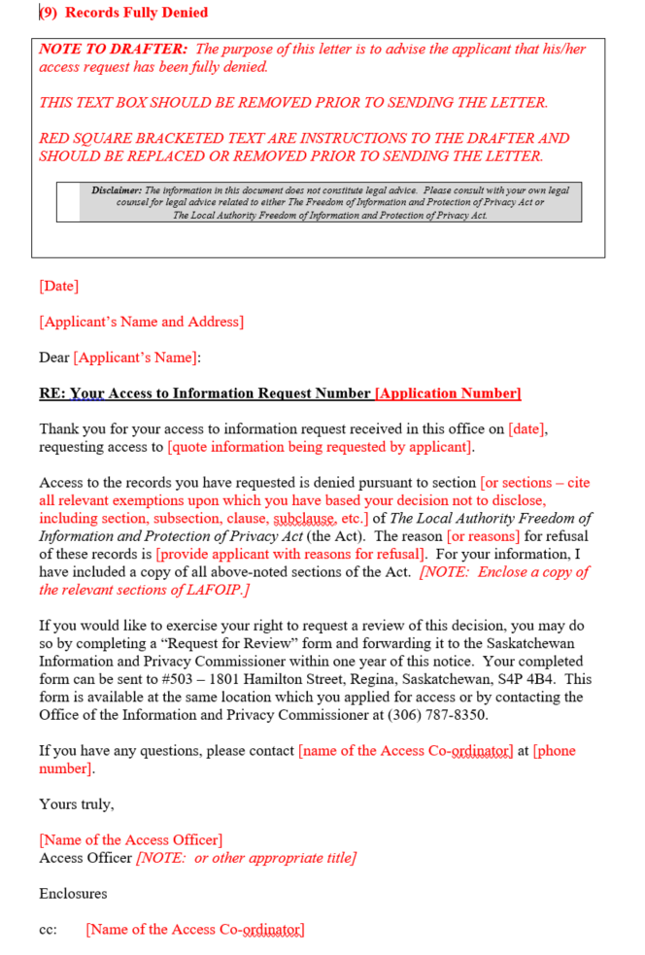
Section 7 response
Last step of the process
Send decision letter to applicant
Templates available at http://www.publications.gov.sk.ca/deplist.cfm?d=9&c=4620
Tailor as necessary

Slide 13
SAMPLE OPERATIONAL POLICY – Access To information
https://oipc.sk.ca/assets/sample-operational-policy-for-municipalities.pdf
Purpose
Scope
Definitions
Policy
Roles and Responsibilities
Related Forms
Reference Material
Form A – Access to Information Request Form

Slide 14
Request for Review
Access request
Public body denial
Citizen requests review by IPC
Telephone call or email
Early resolution attempts
Notification letter
Ask for index of records
The record – IPC will not release
Submission
14 days
Draft Report - comment 7 days
Final Report
On website 3 days later
Public body has 30 days to respond
Applicant or third party can appeal to the court
*A chart of the process is available on our website at http://www.oipc.sk.ca/Resources_Citizens_Access.htm

Slide 15
Review Reports
223-2018
193-2018
140-2018
035-2018

Slide 16
Privacy

Slide 17
It’s all about me
Information privacy defined:
Right of an individual to determine for him/herself when, how and to what extent he/she will share his/her “personal information”
Personal information defined:
Generally, its is information about an identifiable individual
Defined by the applicable privacy law
Others opinions about me are my personal information

Slide 18
Not personal information
No concern if de-identified, or provided as statistics only, or as aggregate data
Employment specific information (i.e. business card information, job duties, salary, etc) and ‘work product’
However, employment history is personal information

Slide 19
Key Terms
Confidentiality
Obligation to protect the personal information entrusted to an organization
Other types of confidential information includes proprietary information such as trade secrets, solicitor-client, cabinet confidences.
No privacy interests engaged as not personal information. Must be protected nonetheless.
Security
Assessing threats & risks to personal information and taking steps to protect

Slide 20
Collection, use, and disclosure rules
Data transactions
Need authority to act
Data minimization principle
Exercise of discretion

Slide 21
safeguards
To prevent privacy breaches implement and utilize physical, administrative and technical safeguards including:
Monitoring, supervising and inhibiting some data practices (‘need-to-know’; user IDs and passwords; locked doors/filing cabinets)
Orientation & Training
Policies and Procedures
Proper Disposal Methods

Slide 22
What to do if a privacy breach occurs
Five Key Steps in Responding to a Privacy Breach
Step 1: Contain;
Step 2: Investigate;
Step 3: Assess and Analyze;
Step 4: Notify; and
Step 5: Prevent.

Slide 23
Investigation by IPC
Breach of privacy complaints
Public body proactively reports
If IPC is satisfied with response, most likely will close file informally
May end in a public report if IPC not satisfied with handling
Citizen asks that IPC investigate
IPC requests public body to do internal investigation
IPC does further investigation
Draft Report to public body (same timelines as in a review)
Final Report (same timelines as in a review)
Posted on IPC website

Slide 24
Prevention is worth a pound of cure!
Adhere to need-to-know and data minimization principles
Information life cycle management
Confidentiality undertakings or pledges
Get it in writing (i.e. contracts, agreements, policies, procedures)
Make sure it’s accurate and complete
Train, train, and train some more
Restrict, suspend or disable user accounts when individuals on leave, change roles or are terminated
Monitor & Audit
Secure destruction

Slide 25
ISSUES AND TRENDS – Quick Takes
Who’s in charge?: mayor or administrator?
What can I charge?: fees beyond application fees
Who owns it?: email accounts and municipal electronic devices

Slide 26
Resources
IPC Website has many resources – www.oipc.sk.ca IPC Guide to Exemptions
Best Practices for Responding to Access Requests
What to Expect During a Review with the IPC
Privacy Breach Guidelines for Government Institutions and Local Authorities
What Councillors should Know about LA FOIP
Best Practices for Mayors, Reeves, Councillors and School Board Members in Handling Records that Contain PI and PHI
LA FOIP Sound Bytes – Q & A Webinars for Cities, Towns, villages, Rural Municipalities, etc

Slide 27
Questions?
Follow us on Twitter
@SaskIPC
Updated resources are at:
www.oipc.sk.ca

