Slide 1
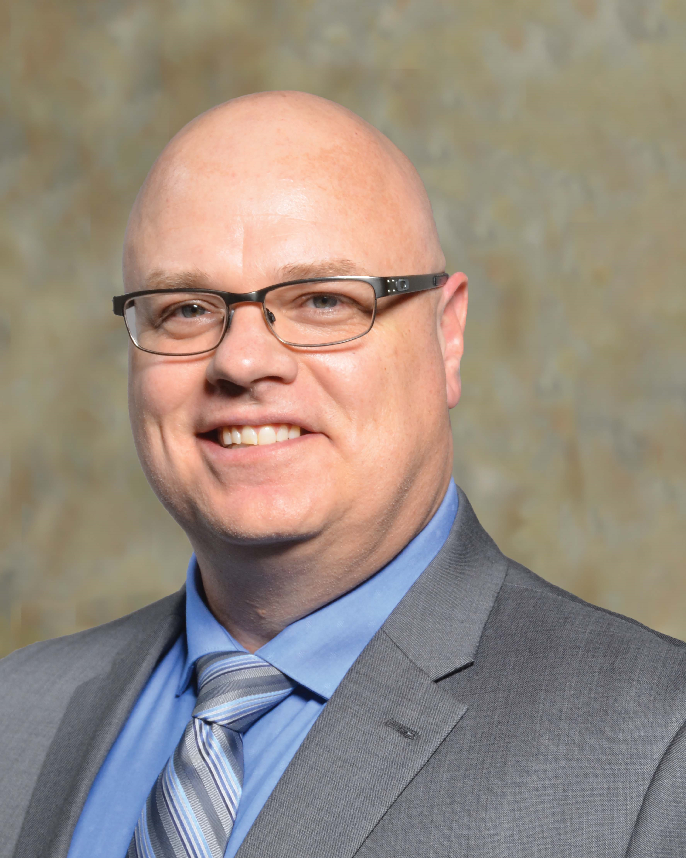
Gerald R. Ford, BA, CSCMP, CPSM, CMC, CPSM
Director of Supplier Development & National Programs
Carl Macdonald, SCMP, CPM
Director of Contracting and Compliance
Gerald is a Supply Chain Management Professional with over 40 years of experience and has worked and consulted for over 100+ different organizations and businesses both in the private and public sector.
Currently Gerald is the Director of Supplier development with Kinetic GPO (Group Purchasing Organization). Gerald manages over 25 different suppliers including Home Depot, CDW, Grainger, Trane and several others. With Gerald’s assistance, Kinetic has increased their membership in 2020 from 100 to 446 members. Kinetic has members in every MASH (Municipalities, Academia, School Boards and Health Care) sector and Province.
For the last 34 years, Gerald has delivering training and educational programs both at Conestoga College and for the Supply Chain Canada and has served on a number of Boards including the Supply Chain Canada Ontario where he was the President in 1993.
Gerald most recently received the Volunteer of the Year Award from the Supply Chain Canada Ontario. In 2021, Gerald was made a honorary life member after 40 years of dedication to the profession. He lives in Cambridge Ontario and in his spare time, Gerald enjoys mentoring and watching football.
Carl is the Director of Director of Contracting and Compliance for Kinetic GPO and currently oversee all contracting activity for the organization.
In May of 2018 Carl joined the Municipalities of Saskatchewan (SUMA) and has worked with Kinetic GPO since October of 2020. Working with these organizations have provided the opportunity to get to know and work with most of the CAO’s in Saskatchewan. Carl also works closely with the Ministry of International Relations and Trade, the Ministry of Trade and Export Development and the Ministry of SaskBuilds and Procurement to help answer any member questions they may receive pertaining to compliancy.
Carl brings over 30 years experience in procurement in both the public and private sectors and although he was born and raised in Saskatchewan and calls Regina home, his career has provided the opportunity to work and live across Canada in Vancouver, Calgary and Quebec City.
Carl currently sits on the Board of Directors of Supply Chain Canada Saskatchewan Institute and holds the designation of Supply Chain Management Professional as well as Certified Purchasing Manager.
www.KineticGPO.ca

