Slide 1
Municipal World Master Class
Effective Orientations
George B Cuff, FCMC
November 2021

Slide 2
Introduction to George
Management consultant since 1979; own firm since 1984
Experience in a variety of professions/occupations: banking, oil & gas accounting, municipal management; communications; politics; consulting
Speaker/advisor to approximately 1100 municipalities and boards across Canada & internationally

Slide 3
Introduction to George
Former Mayor, President of provincial and federal associations of local government leaders
Advisor to Provincial Government on ABCs & Provincial departments
Author of 10 books and 400+ articles on local government (www.municipalworld.com)

Slide 4
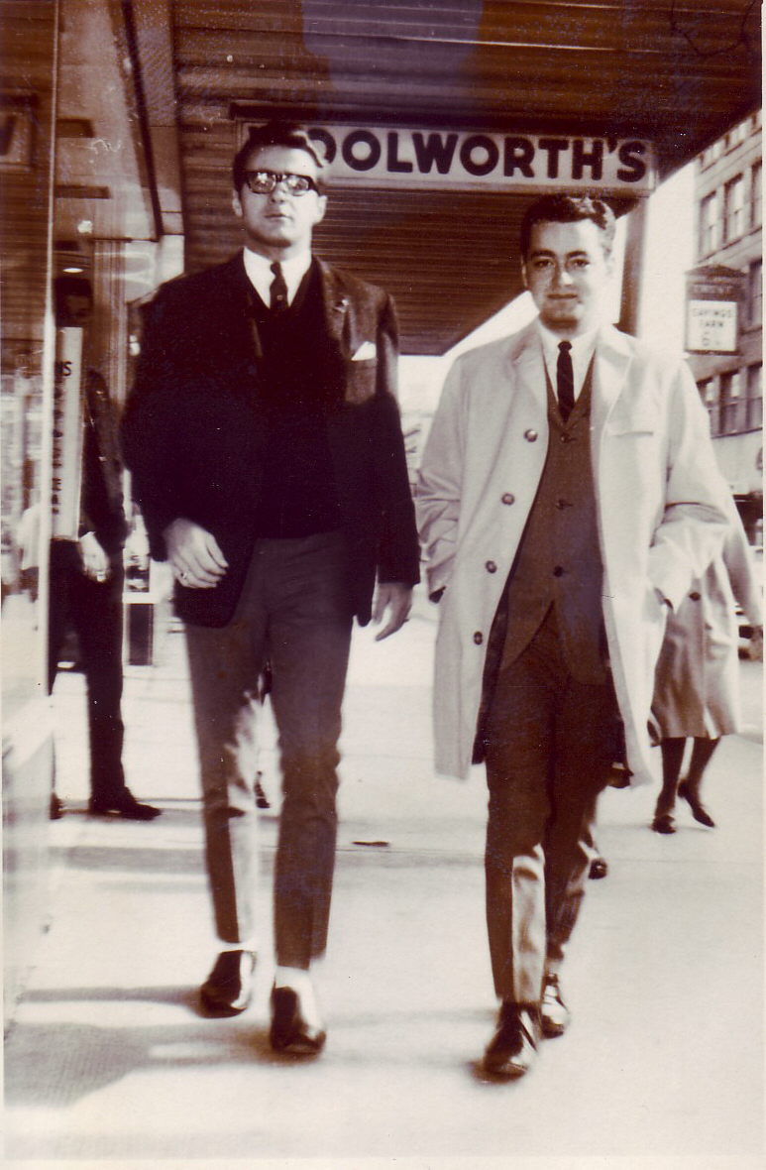
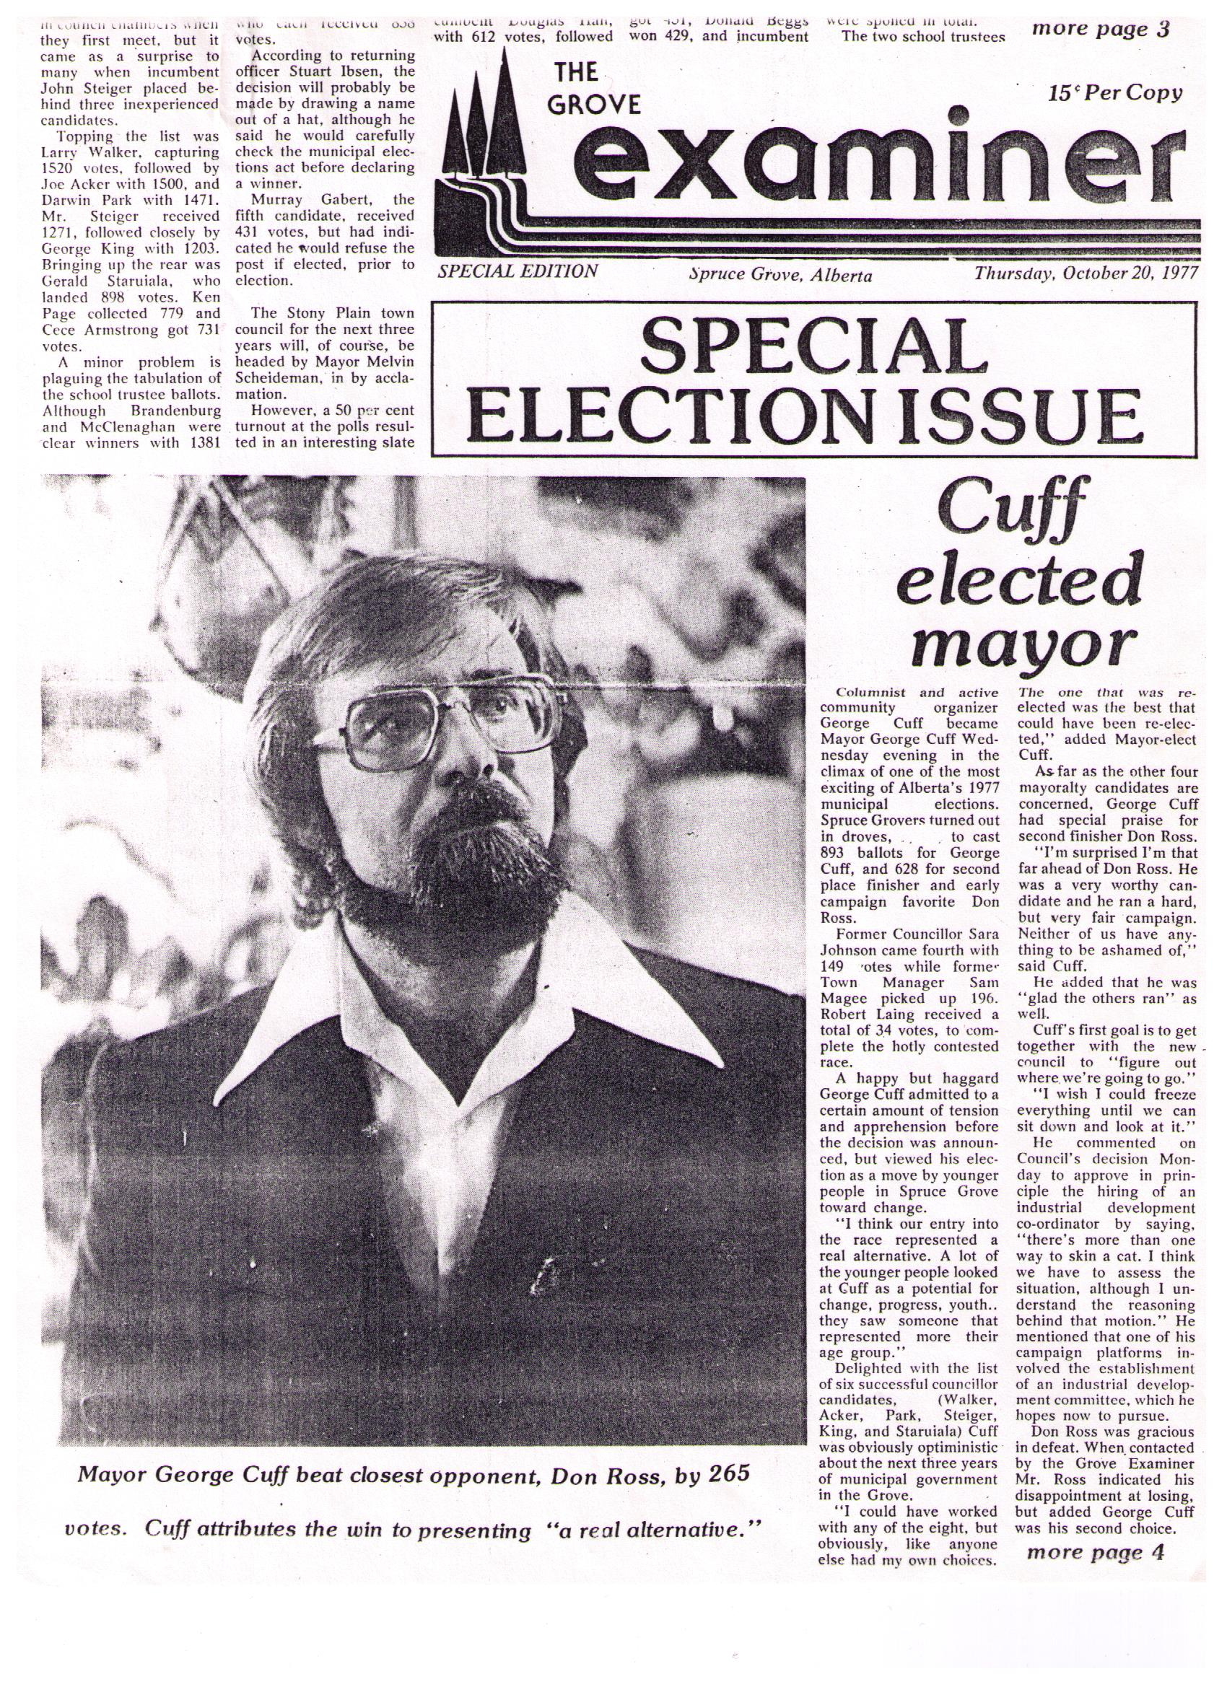
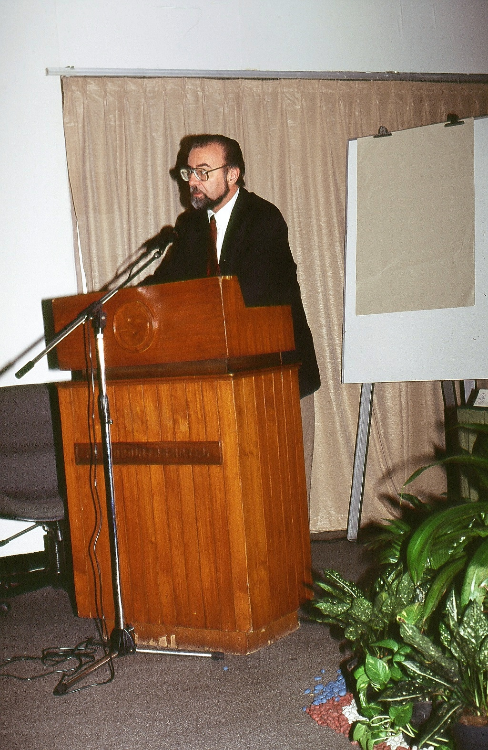
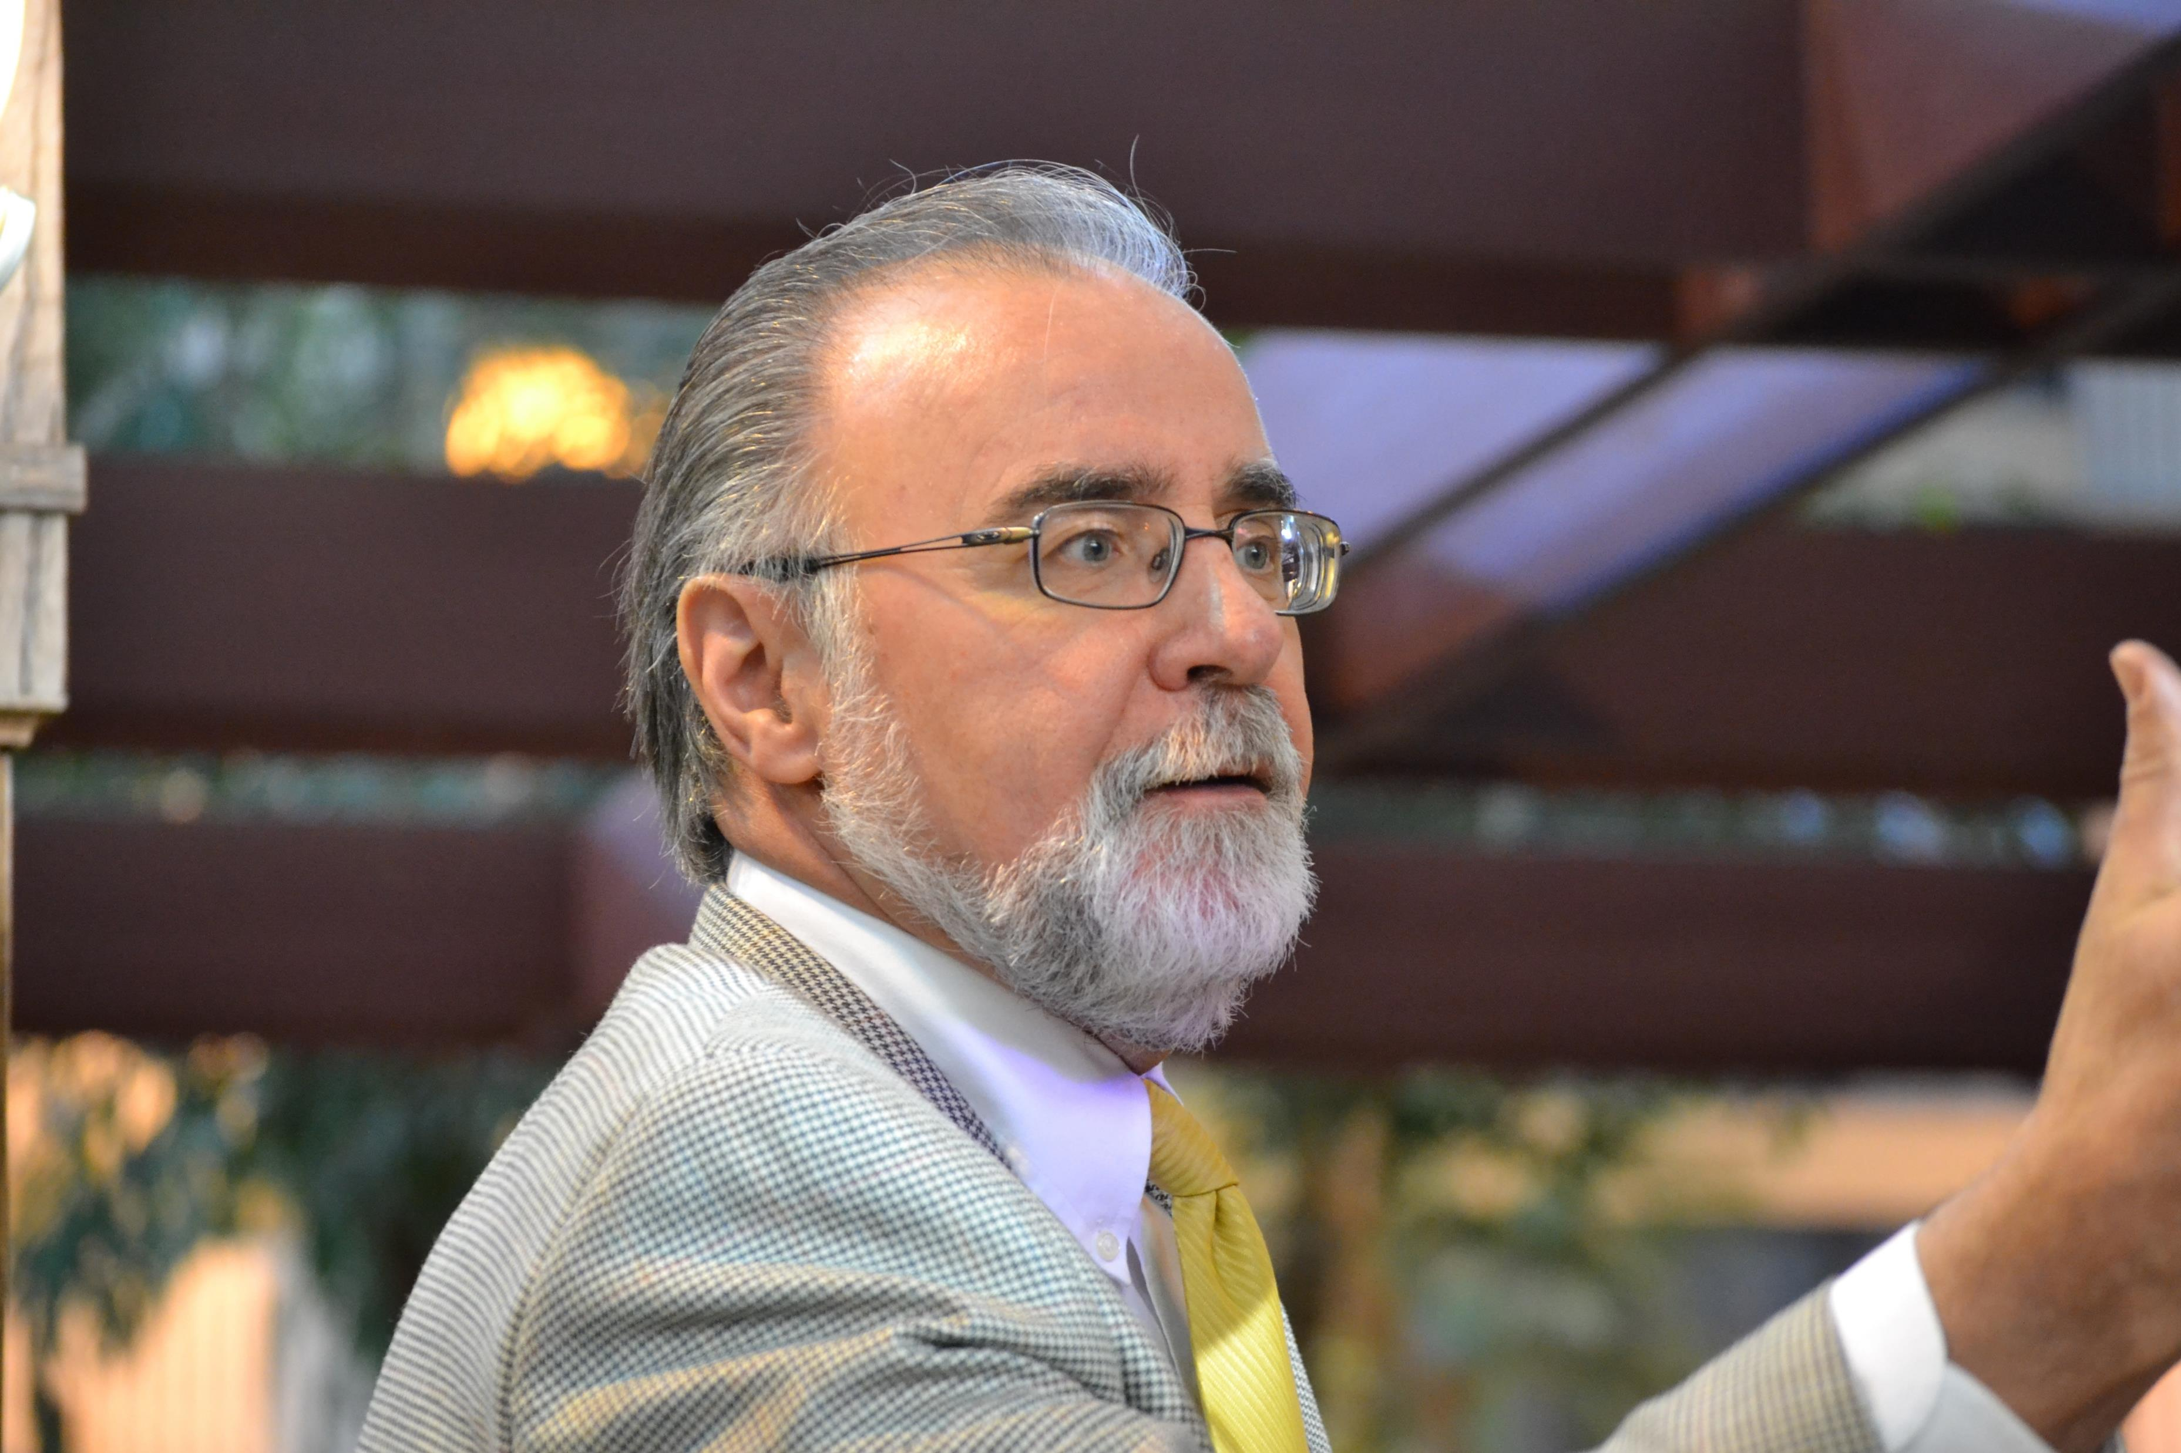
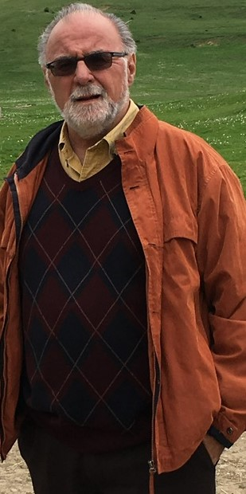
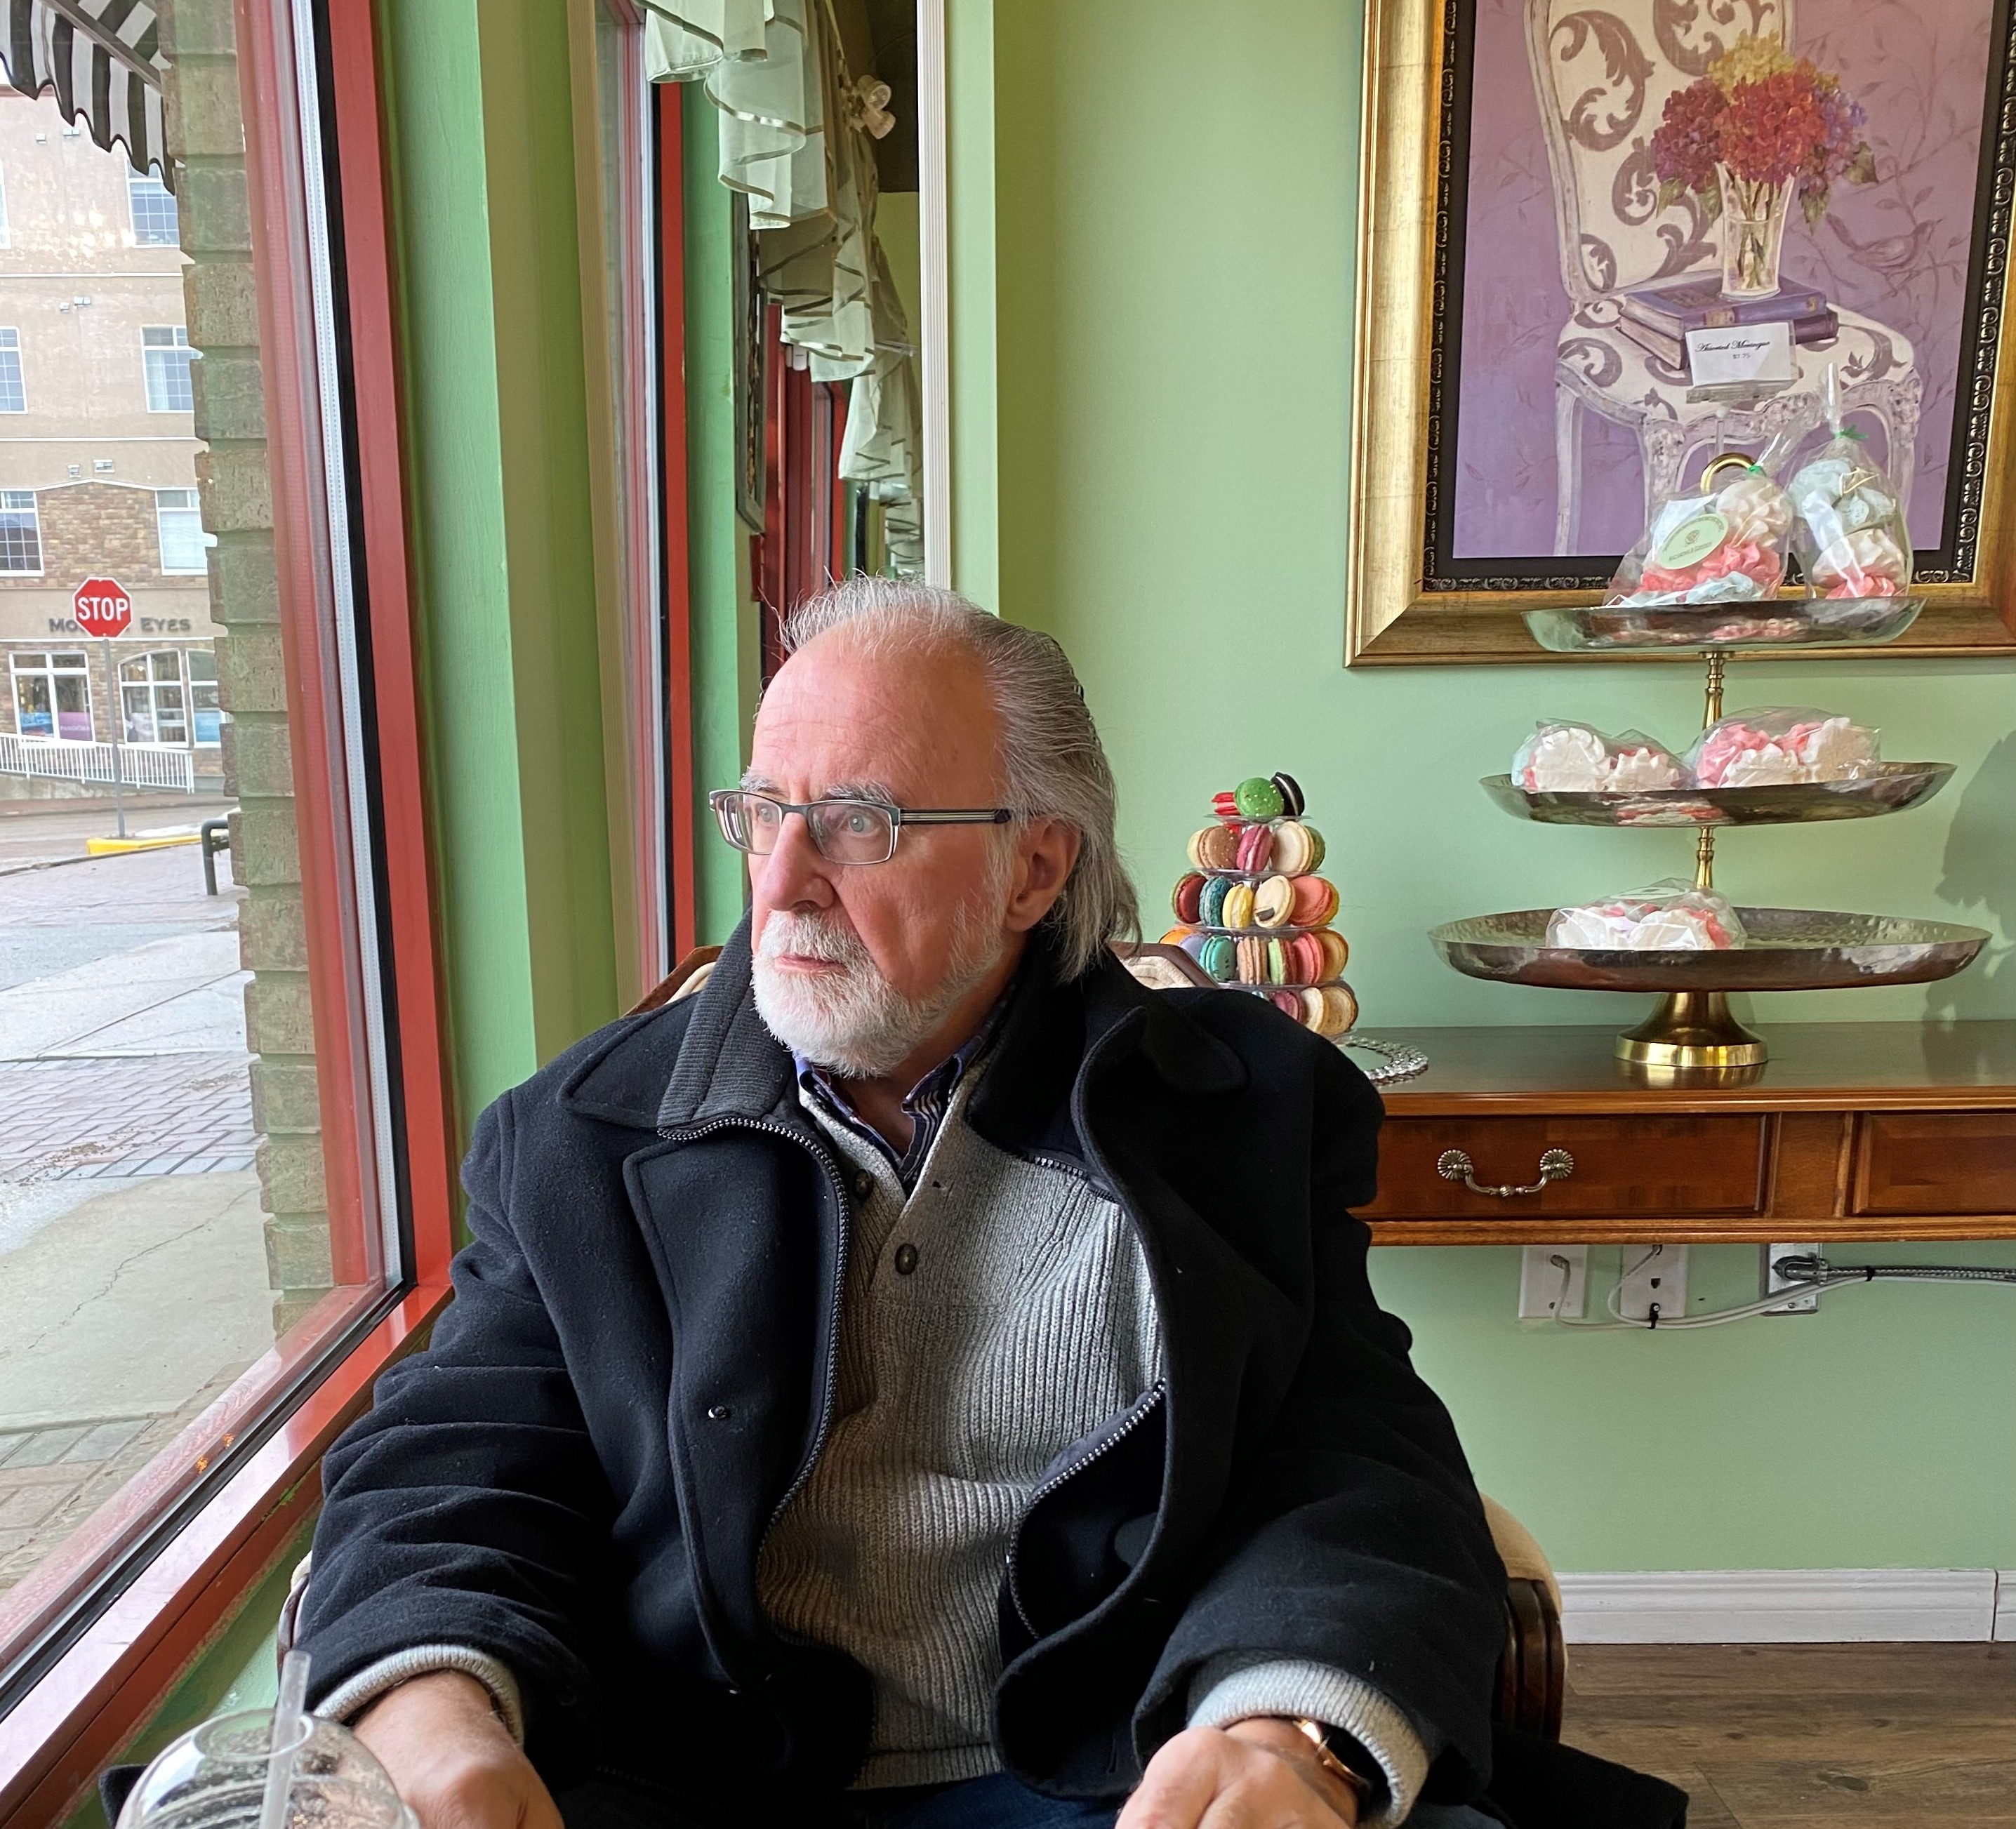
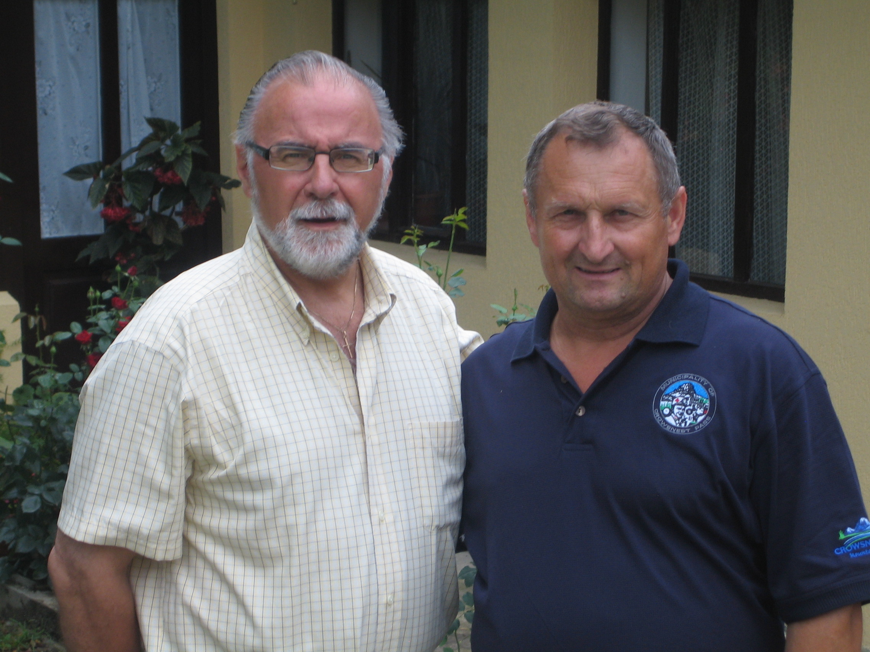

Slide 5
Recent Engagements (2020-21)
EMRB (Seminar on Good Governance for a Regional Board)
25+ Orientation Seminars (Alberta, Yukon, NWT)
District of Vanderhoof, BC (Governance Audit)
Federation of PEI Municipalities (Webinar)
Municipalities of Saskatchewan (Webinar)
Saskatchewan Econ Development (Webinar)
City of Yellowknife (CM Bylaw; ABC review)
City of Regina (Seminars)

Slide 6
Recent Engagements (2020-21)
City of Nanaimo, BC (Governance Review & Follow-up)
Legal Aid Alberta (Management/Structure Review)
City of Fort Saskatchewan (Governance Audit)
ICMA Good Governance Modules
RDAR (Results Driven Agricultural Research); new Provincial organization; (Governance Advice)
East St. Paul, MB, (Governance Audit; Webinar)
Municipal World, Webinars (10 Basics of Quality Governance)
Saskatchewan Orientation Seminars (Nipawin, Moose Jaw, Weyburn, Swift Current, Regina)

Slide 7
AGENDA
Where to Begin; When to Start
Purpose; Attendance
Focus; Who Facilitates; Menu
Logistics
Introduction to System, Projects, Processes
Our Legislative Base
The Governance Challenge
Elements of Good Governance
Legacy Thinking
Questions

Slide 8
Where to Begin
The key to any successful presentation to a body of elected officials is this:
  Clarity of Purpose: What does success look like? What are you trying to accomplish?
  Educate for What? Are you hoping to educate your Council members on what local government is about, on what you do in the organization and why that is so vitally important?

Slide 9
Where to Begin (2)
  Should a Councillor understand municipal finance so they can sound like you in the eyes of their public?
  Is it important that they understand the jargon used by your Planner, Engineer, Parks & Rec professional?
  If a Councillor comes from a legal background, should the rest of Council listen to them explain what pecuniary interest is all about? OR is such a person simply one of you?

Slide 10
Orientation: When to start (1)
Pre-briefing? Should it be done?
If so, who attends?
Who presents?
What is presented?

Slide 11
Orientation: When to start (2)
What should administration do?
Need for pre-planning
Consider as a major event
Ensure lessons learned applied
Prepare as though…

Slide 12
Purpose of the Orientation
Ensure familiarity for all
Begin relationship building
Introduction to a new world
Familiarity with logistics
The key roles

Slide 13
Who should Attend?
All or new members of Council?
All or few members of administration?
Any external players?
What about key advisors?

Slide 14
The Orientation: When/Where?
Immediately following election OR?
After swearing in ceremony
In Council Chambers OR?
At off-site location?

Slide 15
The Focus
Preparing for the first few days; advice to new members on what to say and not
Your world has just changed!
AND
A Council is focused outward, on the community far more so than inward
Their principal role is on representing their audience

Slide 16
Who Facilitates?
Coordinated by the CAO
Sets the tone
Facilitated by the Clerk’s office
Orientation on roles different story

Slide 17
What’s on the Menu?
Welcome/introductions
Logistics
Tour
Introduction to the system
Timing/itinerary of next steps

Slide 18
Logistics & Awareness
Swearing in process
Practice “Mock” Council Meeting
Access to Municipal Office
Parking space
Photos/Bio Sketches for Website
Electronic services
Using municipality letterhead/symbols

Slide 19
Logistics: Mock Council Meeting (1)
Seating of Council members
Seating of administration
Opening process
Procedures
Motions/seconded
Voting
New items?

Slide 20
Logistics: Mock Council Meeting (2)
Delegations
Time of meetings
Role of chair
Decorum in Chambers
Dealing with major issues

Slide 21
Logistics: Office Staff Support
Are any staff designated to Council
If not, who is key contact
Does Council contact CAO or?
What level of contact off limits?

Slide 22
Logistics: Getting Paid
Covered by policy
Honoraria review every ?? years
Citizens committee reviews
Last review xxxx
Paid monthly
Covers the following…

Slide 23
Logistics: Expenses
Covered by policy
Expense rates review every year
Policy/regulations authorize
Out of pocket for pre-allowed expenses
Also set by total amount allowed per Councillor

Slide 24
Logistics: Tour of Facilities
Will include Municipal Hall, major recreation & cultural facilities; water and sewage treatment facilities; current major projects
Council provided with key contacts list for any citizen concerns
Usage of rec facilities and fees associated with covered by municipal policy

Slide 25
Introduction to System and People
CAO will introduce system
Councillors receive partial org chart
Protocol limits direct contact
CAO or direct reports only
Direct reports to be introduced
These are Council’s key resources

Slide 26
Current Projects
CAO provides overview
Projects include recently completed; currently underway; contemplated
Projects may be internal, external, shared
Budgets outlined; any cost concerns
Next budget will cover those contemplated

Slide 27
Council Processes (1)
Appointments to Council Committees
  Mayor will review & recommend
  Choices on who serves where
  Council policy to limit to maximum of 2-4 years on any committee
  Exceptions can be made

Slide 28
Council Processes (2)
Appointments to ABCs
  Appointments made by Mayor
  Determined by policy & choice
  Most ABCs meet evenings
  All report to Council as advisors
  Policy to rotate regularly
  No one to hold executive positions

Slide 29
Council Processes (3)
Representing the Municipality
  Each Council member expected to serve if asked
  Mayor’s office receives requests
  Mayor attends if available; DM or others called as back-up
  Advise if time constrained
  Office provides greeting
  Gift extended if appropriate
  Report to office any issues

Slide 30
Council Processes (4)
Accessing Management
  Protocol limits to CAO & direct reports
  Any request reported to CAO
  All information shared
  Power to direct? (CAO)

Slide 31
Council Processes (5)
Handling Citizen Complaints
  Refer to “complaints desk”
  Or refer to office of CAO
  If directed to Mayor or Council; ensure copy
  Ensure loop closed

Slide 32
Council Processes (6)
Strategic Planning
  Process of priority thinking
  Conducted annually prior to budget
  All of Council involved
  External facilitator
  Dates set 6 months in advance
  Community-wide process every 3 years

Slide 33
Council Processes (7)
Business Planning/Budget Process/Timing
  Budget process for Council
  Budget process for management
  Business plan tied to budget
  Council process October 1st to December 15th annually
  Processes reflect Strategic Plan

Slide 34
Council Processes (8)
Review of CAO
  Council committed by policy
  Conducted annually by Council
  May utilize 360° process (3 year cycle)
  Requires input of CAO
  May use external facilitator
  Important process

Slide 35
Finished? No…Now the Important Stuff

Slide 36
The Governance Challenge (1)
Legislated Roles of Mayor & Councillors
  Generally Accepted Roles
Legislated Roles of CAO
  Generally Accepted Roles
Other Legislated Roles: Clerk, Treasurer
Governance Principles
Meeting Procedures

Slide 37
The Governance Challenge (2 of 3)
Governance Model
Governance Practices
Priority Setting
Policy Making/Bylaws/Resolutions
Governance Protocols
Council’s Levers of Power
  e.g., Bylaws, policies, resolutions, budgets, CAO contract, CAO performance review

Slide 38
The Governance Challenge (3 of 3)
Corporate Team Building
Council-CAO Covenant
FOIPP
Legacy Building
Personal Impact
Summary Messages

Slide 39
What Do These Mean?
What roles are prescribed by law? Which are “generally accepted good practice?”
What defines roles of CAO? Why is a CAO critical to how well Council governs? Who establishes their bylaw, contract, position description?
What are the roles of the Clerk & Treasurer? To whom do they report? Why?

Slide 40
Governance Principles (1)
1. Adherence to decision-making protocols
2. Primacy of the Council Table
3. Open meetings
4. Regular and transparent reporting
5. Apolitical administration
6. Interests of the whole
7. Oversight to the administration, the budget, the municipality’s fiscal health, key priorities, relationships

Slide 41
Governance Principles (2)
8. Participation
9. Respect for the administration
10. Mayor as spokesperson for Council
11. Ethical government
12. Good neighbours
13. Self-regulating
14. Accountability

Slide 42
What Do These Mean?
Meeting procedures? Yours or Robert’s?
Governance model? Yours or your predecessors?
Priority-setting? Now or when? Led by whom?
Policy review? Now or stay the course; nothing changed
Protocols? Internal policies; how we do business
Team-building? When; do we wait for signs of decay?
Council-CAO Covenant? Don’t have one; contact George

Slide 43
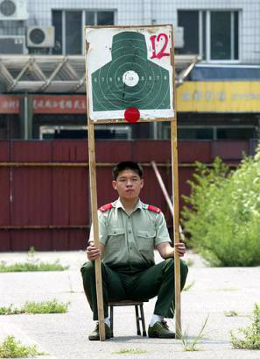
Finally: Did we Hit the Target?
“There is nothing more useless in life than doing efficiently that which should not be done at all” (Peter Drucker)

Slide 44
How About Your Legacy (Admin)
You spent considerable time planning for the arrival of a new Council
You thought through the issues of this past term
You determined that things could be better
You are committed to assisting this Council become more of a policy governance body & less focused on the operations
You set personal and managerial goals
You found templates that work; improved understanding of what makes management function as intended
Your footprints say that good governance has never been better

Slide 45
Council’s Legacy
Enhanced orientation process/advice/materials
Clear explanation of key legal matters
Understanding of key roles: Mayor, Councillor, CAO
Commitment to a policy governance model
Refreshed procedural bylaw
Assessment of committee (governance) model
Projects, public engagement, Council “in” community

Slide 46
Council’s Legacy
Reputation as a governing body was enhanced
Relationships in the region better than when you started
Fewer arguments, less whining on Council; we are in this together
Less grandstanding; fewer individuals taking credit
Less grandstanding; fewer individuals taking credit
Enhanced orientation process, new/revised policies, procedure bylaw & meeting processes, strategic planning process
Agenda building, budget process, governance model, code of conduct, public engagement strategy, communications plan

Slide 47
Questions?
Books available www.municipalworld.com
Videos for your Council: www.georgecuff.com
Mission to Romania: assistance to a children’s camp: contact George if you are interested in helping www.rootsinromania.com
Questions: contact George at george@georgecuff.com

Slide 48
In Summary
Some leaders understand power; others understand authority; a few recognize people; most never understand the need to focus on results.
The public will is what people would choose if they saw clearly; thought wisely; and acted benevolently. (Walter Lippman)

