Slide 1

BYLAW TRAINING SERVICES
BYLAW TRAINING SERVICES - umaAs Conference June 3, 2026
Notes:
Thank you to the Conference organizers for inviting me and thank the session sponsor OurSask-Info
My Background
Employed by SaskTel – 1970-2000
1970-83 – Saskatoon, Operations & Training. President STDA
1984 -2000 – Regina, Marketing, Business Development, Strategic Planning
Gourlay & Associates
Incorporated 2000, Project Management, Research, Strategic Planning
Contracted with dozens of organizations in a variety of industries across Saskatchewan
My first introduction to municipalities
Moved to Turtle Lake – 2003 -2015
served as the Reeve of the RM of Parkdale 2010-12 – first exposure to bylaws
2015 Return to Regina
2017 Commissionaires as a BEO
Regional Bylaw Services – serving 12-15 communities NW of Regina
Observed an unserved training requirement and launch Bylaw Training Services in the fall of 2023 with the input from.
Focuses on Comprehensive Curriculum, Experienced Instructors, Flexible Learning Options. In excess of 120 people have now completed the training

Slide 2
10 POINT CHECKUP
COMPREHENSIVE BYLAWS
COMPLAINT MANAGEMENT
INSPECTIONS, NOTIFICATIONS, SERVICE, APPEALS
REMEDIATION
PROSECUTION
REPORTING
TRACKING & ANALYSIS
COMMUNICATION
POLICY ADAPTATION
RESOURCES
Notes:
The presentation is compilation of the Best Practices and Pit Falls learned from our experience.

Slide 3
COMPREHESIVE BYLAWS
The authority to regulate on both private and public lands within municipalities is primarily encompassed in the Municipalities, Cities, Northen Municipalities and Planning & Development Acts
A council may exercise its powers by the passing of bylaws or resolutions
Authority also exist within other acts
  Trespass to Property Act
  Traffic Safety Act
  The Fire Safety Act
  The Construction Codes Act
  ATV & Snowmobile Acts

Slide 4
COMPREHESIVE BYLAWS
Do your bylaws contain all the required elements
  Declaration citing the relative Act, section etc.
  Short Title
  Interpretation section
  Purpose
  Contraventions
  Enforcement Process citing the relative Act, section etc
  Effective Date
  Schedules

Slide 5
BYLAW COMPLAINT MANAGEMENT
  A well defined and centralized contact that can intake and re-direct reports of bylaw contraventions to the bylaw officer for inspection
  Assures fairness and confidentiality
  Accepts only first-hand witnesses (cautionary note to staff & councilors)
  Keeps accurate and retrievable records
  Tracks and reports back to complainants on the status of matter
Notes:
Centralize the Complaint Management responsibilities for effectiveness, efficiency and accountability. Avoid the “too many cook spoil the stew” syndrome.
Assure complainants that their name will be kept confidential
Societal demands expect responses and closure

Slide 6
INSPECTIONS
Ensure council appoints a designated Bylaw Officer as per the Municipalities or Cities Acts.
In the absence of a designation by council, the CAO is the “designated officer”
Inspections and the issuance of Orders to Remedy, Summary Offence Tickets and Notice of Violation Tickets can only be executed by a designated Bylaw Officer.
Notes:
Rarely does a BEO need to enter private property

Slide 7
NOTIFICATIONS & SERVICE
Warnings can be issued by any municipal officer with the authorization of the CAO.
Warnings are best served by regular mail.
OTRs are best served by registered letter
SOTIs require personal service
Written orders issued by a Bylaw Officer shall be served by the municipality
Costs incurred prior to a compliance date are not recoverable
Notes:
It is my preference to serve all warnings by regular mail and OTRs by registered mail. SOTIs do require personal service
MA, s364 (2) The municipality shall serve a written order on the person to whom the order is directed.

Slide 8
APPEALS
All bylaw enforcement actions provide for an appeal to an impartial 3rd party.
OTRs issued under the Municipalities or Cities Acts can be appealed to council or a committee appointed by council.
OTRs issued under the Planning & Development Act can only be appealed via the Development Appeals Board.
Tickets that are applying fines can be paid voluntarily or adjudicated through the Provincial Summary Offences Bylaw Courts.
Notes:
BEO / CAO / Council – can not take on the role of prosecutor, judge and executioner. There always needs to be an impartial third party appeal mechanism.
We all play a critical role in ensuring the integrity of the appeal process.

Slide 9
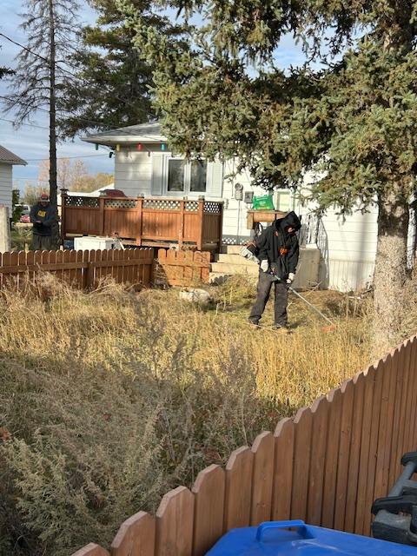
REMEDIATION
A municipality may take whatever action or measure is necessary to remedy a contravention of a bylaw or to prevent a reoccurrence.
Costs related to the remediation or prosecution of a bylaw contravention are amounts owed to the municipality.
Request Police assistance to keep the peace when remediating properties
Notes:
Remedial Actions
Discuss the municipalities broad authority to acquire resources to remediate properties.
Discuss Standing Order to prevent reoccurrences. Cite MA, s6 broad interpretation
Police Assistance
The police are there to ensure everyone’s safety. There are not there to execute the order or to serve as point of appeal or adjudication.

Slide 10

PROSECUTION
Costs related to the prosecution of a bylaw contravention are amounts owed to the municipality.
Prosecution costs related to Summary Offence tickets can only be recovered through the fine amount specified in the bylaw. If no amount is specified in the bylaw, the default amount is $2,000 for an individual and $5,000 for a corporation.
Notes:
Prosecution costs related to Summary Offence tickets can only be recovered through the fine amount specified in the bylaw. If no amount is specified in the bylaw, the default amount is $2,000 for an individual and $5,000 for a corporation. MA, s381 (3) (b)

Slide 11
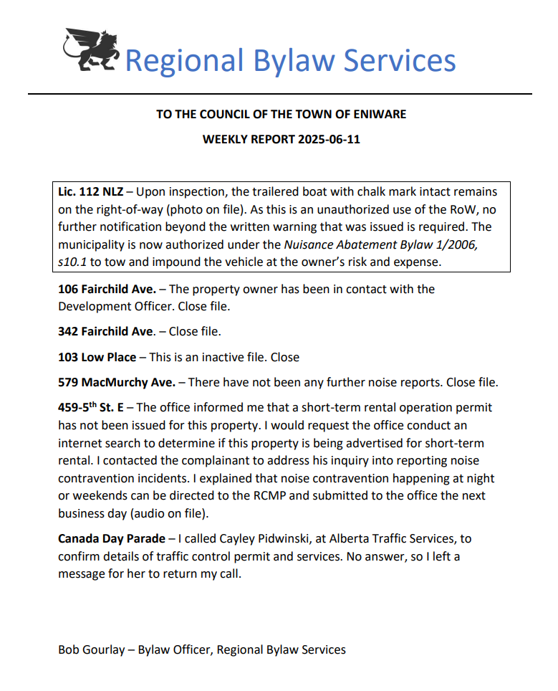
REPORTING
  Provides regular and frequent details regarding bylaw complaints, inspections, orders, remediation and prosecution.
  Reports provide an effective tool to educate Council and Staff as to the authority and process in which bylaws are enforced.
Notes:
Reports record the contemporaneous details and evidence from the inspection
Keep council and staff abreast of the BEO’s activities
Provide an effective tool to educate Council and Staff as to the authority and process in which bylaws are enforced.
provide an effective tool to educate Council and Staff as to the authority and process in which bylaws are enforced.

Slide 12
TRACKING & ANALYSIS
The Bylaw Tracking System
  Builds a repository of easily retrievable documentation to assist in decisions and policy changes.
  Provides the current status of the number of non-compliant properties and open files within the municipality
  Reports on overall bylaw compliance in relation to goals

Slide 13
TRACKING & ANALYSIS
Notes:
Describe the features of the tracking tool
Describe the features of the analysis tool

Slide 14
COMMUNICATION
The Bylaw Communication System
  Eliminate contraventions before they happen by reminding people of the municipal bylaws
    Typically, upwards of 95% adhere to bylaws that they are aware of
    (see seasonal bylaw reminders calendar)
  Keeps citizens aware of general bylaw enforcement activities
    Articles on the municipal website, newsletter, Facebook updating and explaining the rationale for various bylaws
Notes:
Enforcement is not the only tool to attain high levels of bylaw compliance in the municipality.
Timely communication including signage is highly effective in changing behaviours

Slide 15

Public Sentiment to Bylaws
What about …
2%
95%
Awareness of bylaw
?
1%
2%
Willingness to comply
Notes:
Discuss the elements of this quadrant
Engage the free, untapped assistance of the public using communication.
Harness the forces of social pressure to change the culture.
Communication especially signage tends to “self deputize” citizenry.

Slide 16
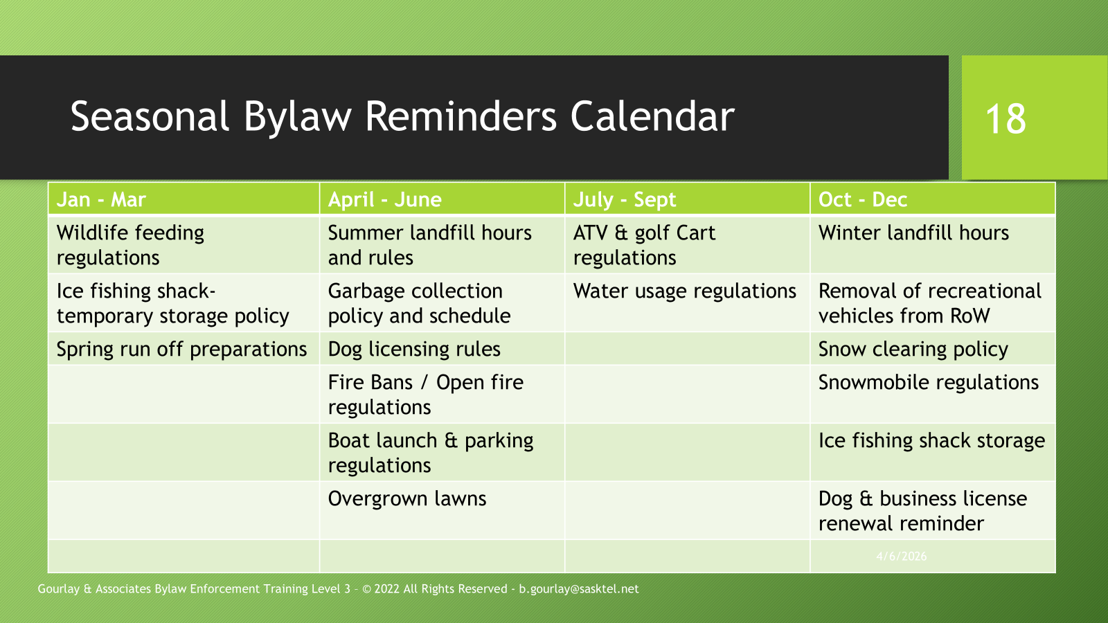
COMMUNICATION
Notes:
Discuss slide

Slide 17
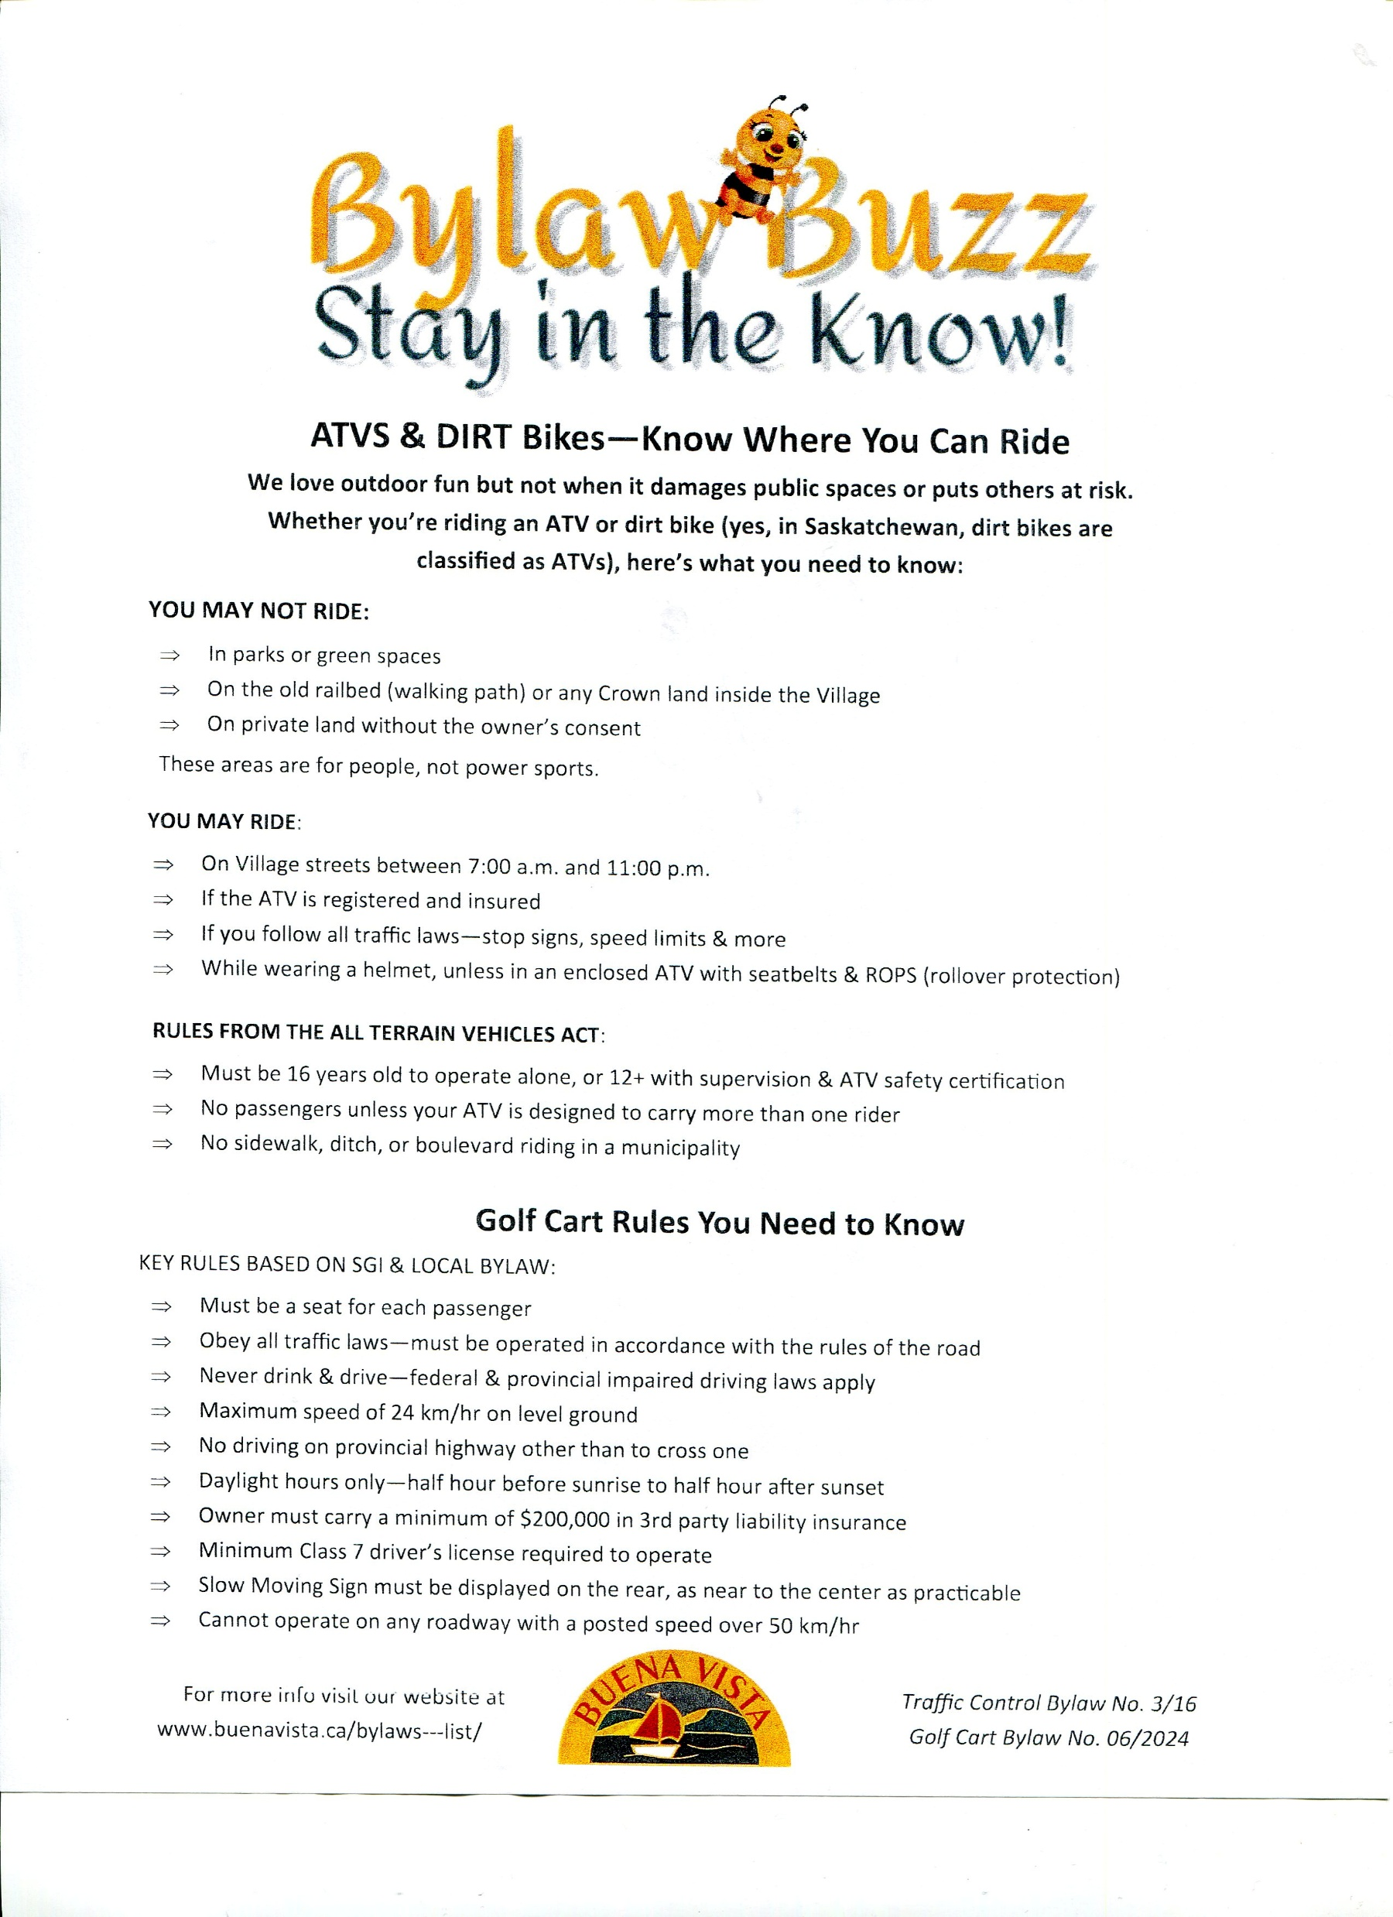

COMMUNICATION
Notes:
Discuss these examples.
Request ideas from the audience

Slide 18
POLICY ADAPTATION
  Bylaw policy decisions need to be based on factual feedback
  Feedback comes from:
    The Bylaw Contravention Report System
    The Weekly Bylaw Reports
    The Compliance Tracking System
    Conduct regular reviews of bylaws and signage regarding parking and uses of public land
    Examples of policy changes: Bylaw Amendments, Changes to Enforcement Procedures, Signage,
Notes:
“ Nothing changes if nothing changes” without a regular review and adaptation of the Bylaw Compliance Program, it becomes a very frustrating and expensive game of Wack-a-mole.

Slide 19
Resources
Yard Clean up services
Towing & Storage services
Pest Control Services
Animal Control & Rescue Services
Coordination with Police
Training Services
Notes:
Get your enforcement resource organized before you need them.

Slide 20
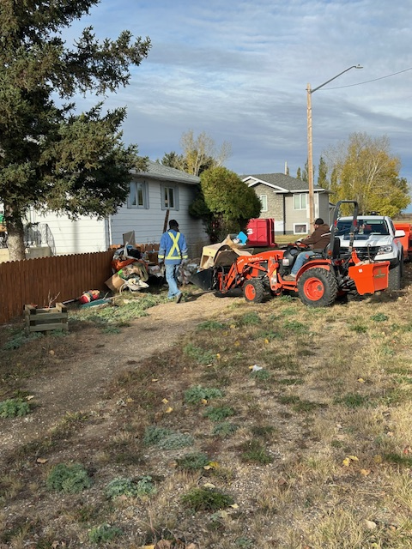
Yard Clean Up Service
Issue tenders to determine
Local contractor interest
Notes:
I recommend the use of local or regional private contractors.
By issuing RFP or tenders it sends a message out to the community, including the bylaw contraveners.
Point to the photo and discuss the efficiency of this contractor.
Lawn & Yard / Tree Removal / Chipping Contractors are well equipped to do the work.
Make arrangement with transfer site operator
Keep track of costs and bill or place on the property taxes.
As agents of the municipality enforcing an OTR, they are immune from prosecution.

Slide 21
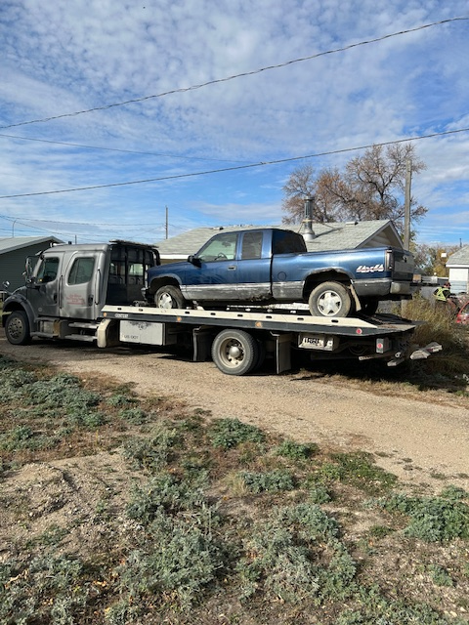
Towing & Storage Services
Check with local RCMP to see what local tow operator that they are using.
Do they have an SGI Certified Storage Compound

Slide 22
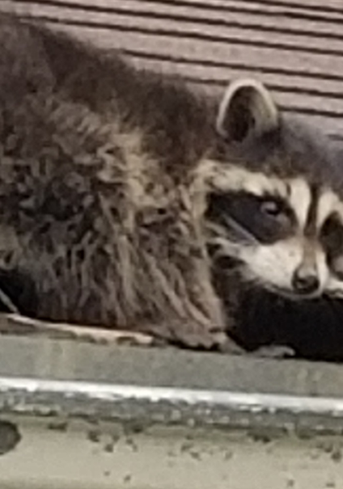
Pest Control
Property owners can be directed to private pest control companies to remove all manner of pests
Some municipalities lend out animal traps to catch nuisance wild and domestic animals

Slide 23
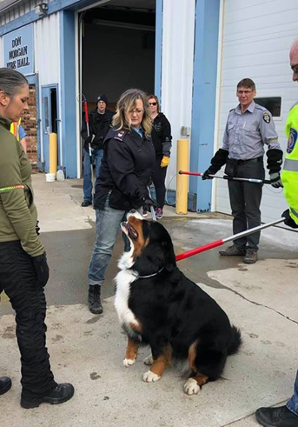
Animal Control
Have a plan and resources for Seizure / Impoundment

Slide 24



Animal Rescue Services
Reporting Animal Abuse
Companion animals and livestock outside Regina: Call SAEA at 306-382-0002 or toll-free 1-844-382-0002. Calls are confidential, and after-hours emergencies are referred to the RCMP www.animalprotection.ca+1.
Regina: Contact the Regina Humane Society at 306-777-7700 for companion animals www.animalprotection.ca.
Saskatoon: Contact the Saskatoon SPCA at 306-374-7387 www.animalprotection.ca.
Wildlife concerns: Contact the Wildlife Rehabilitation Society of Saskatchewan at 306-242-7177 or Saskatchewan Environment at 1-800-567-4224 sk.211.ca+1.
Reports can also be submitted online via the SAEA or APSS websites, and complainant information is kept confidential
Check the KAWS – Saskatchewan Animal Rescue site for resources in your community
Sask Rescues - KAWS Animal Rescue

Slide 25

Animal Distress or Abuse Services
Call the Saskatchewan Animal Enforcement Agency at 306-382-0002 regarding animals in distress
Call the Wildlife Rehabilitation Society of Saskatchewan at 306-242-7177 or Sask Environment at 1-800-567-4224

Slide 26
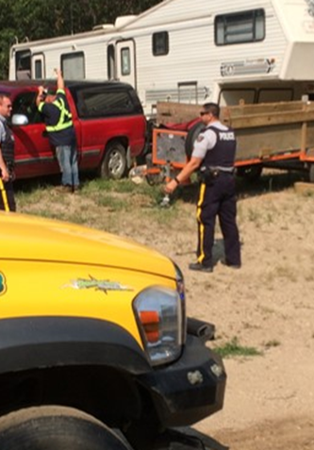
Coordination with Police
Meet with local police service and clarify roles related to bylaw enforcement

Slide 27
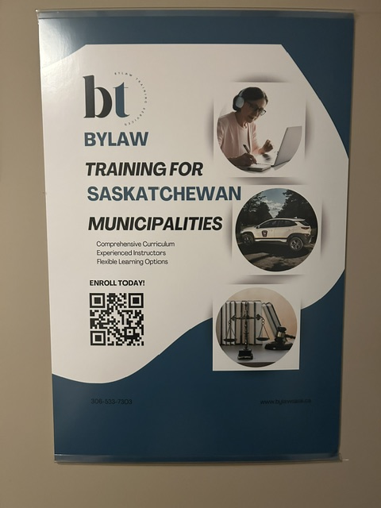
Bylaw Enforcement Training

Slide 28

Questions & Answers

Slide 29
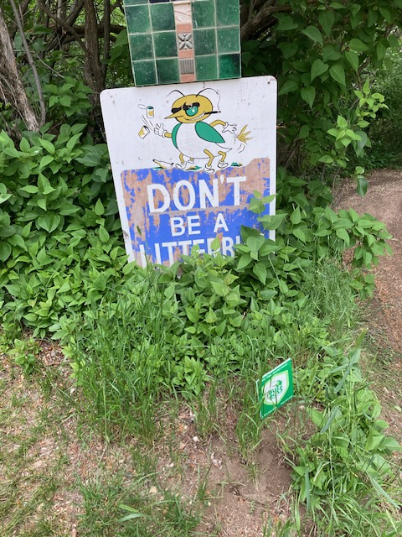
Some Final Thoughts

